Slide 1
Finite Automata to Regular Expression
GNFA Method
Slides by Saumya Gupta
CSE303, Stony Brook University (2021-10-04)

Slide 2
Overview + What is GNFA?
We will show that any finite automata (DFA/NFA) can be converted into a regular expression.
We will create a GNFA (Generalized Non-Deterministic Finite Automata) from the given DFA/NFA diagram.
In DFA/NFA, we are only allowed to write ε or members of the alphabet on the transition arrows. In a GNFA, we are allowed to write regular expressions on the transition arrows.
The basic idea of converting the DFA/NFA to GNFA is to keep removing states from the given DFA/NFA diagram until we are left with only one START and one FINAL state in the GNFA.
On removing states, we will write regular expressions on the transition arrows. The final GNFA diagram will have only one transition arrow from one START state to one FINAL state. The regular expression on this transition arrow will give us the answer to the desired regular expression.

Slide 3
GNFA Guidelines
For convenience, we require our GNFA at all times to be of the following form:
There is only one START state. This state has no incoming arrows.
How to achieve this? Add a new START state with an ε arrow to the old START state.
There is only one FINAL state. This state has no outgoing arrows.
How to achieve this? Add a new FINAL state with ε arrows from all the old FINAL states.
The START and FINAL state are not the same.
How to achieve this? The above two steps will ensure that START and FINAL state are not the same.

Slide 4
Top-level outline of conversion
We will convert the DFA/NFA to a regular expression as follows:
Convert DFA to GNFA by adding new START and FINAL states as mentioned in the previous slide (slide 3).
Remove all states one-by-one, until we have only the START and FINAL state.
Output regex is the label on the single transition left in the GNFA.

Slide 5
Ripping process : How to remove a state?
At every step, we need to construct an equivalent GNFA with one fewer state, till we only have one START and one FINAL state remaining.
We do so by selecting any state (≠ START, FINAL), ripping it out of the machine, and repairing the remainder so that the language is still recognized. The order in which the states are ‘ripped out’ does not matter because ultimately we need to have ripped out all the states (≠ START, FINAL). Let the ripped out state be q_{rip}.
After removing q_{rip}, we repair the machine by altering the regex on each of the remaining arrows.

Slide 6
Ripping process : How to remove state q_{rip}
R₄
In the old machine, if
q_{i} goes into q_{rip} with an arrow labeled R₁
q_{rip} goes to itself with an arrow labeled R₂
q_{rip} goes to q_{j} with an arrow labeled R₃
q_{i} goes to q_{j} with an arrow labeled R₄
R₂
R₁
R₃
q_{i}
q_{rip}
q_{j}
old machine
Then in the new machine, the arrow from q_{i} to q_{j} gets the label: (R₄) U (R₁) (R₂)* (R₃)
We have to make this change for each arrow coming from any incoming state q_{i} to any outgoing state q_{j} including the case where q_{i} = q_{j}. The resulting machine is equivalent to the old machine, with one fewer state.
(R₄) U (R₁)(R₂)*(R₃)
q_{i}
q_{j}
new machine

Slide 7
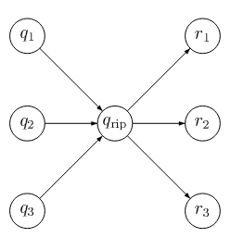
Steps
Convert DFA/NFA to GNFA by adding new START and FINAL states as mentioned in slide 3.
For every state (≠START,FINAL) we need to remove it from the machine. Let one such state be q_{rip}.
For each pair of states q_{i} and r_{i} as shown in the figure, we need to convert the transition through q_{rip} into a direct transition from q_{i} to r_{i} using the method shown in slide 6.
Step 2 is done till we are left with only 2 states, one START and one FINAL state.

Slide 8
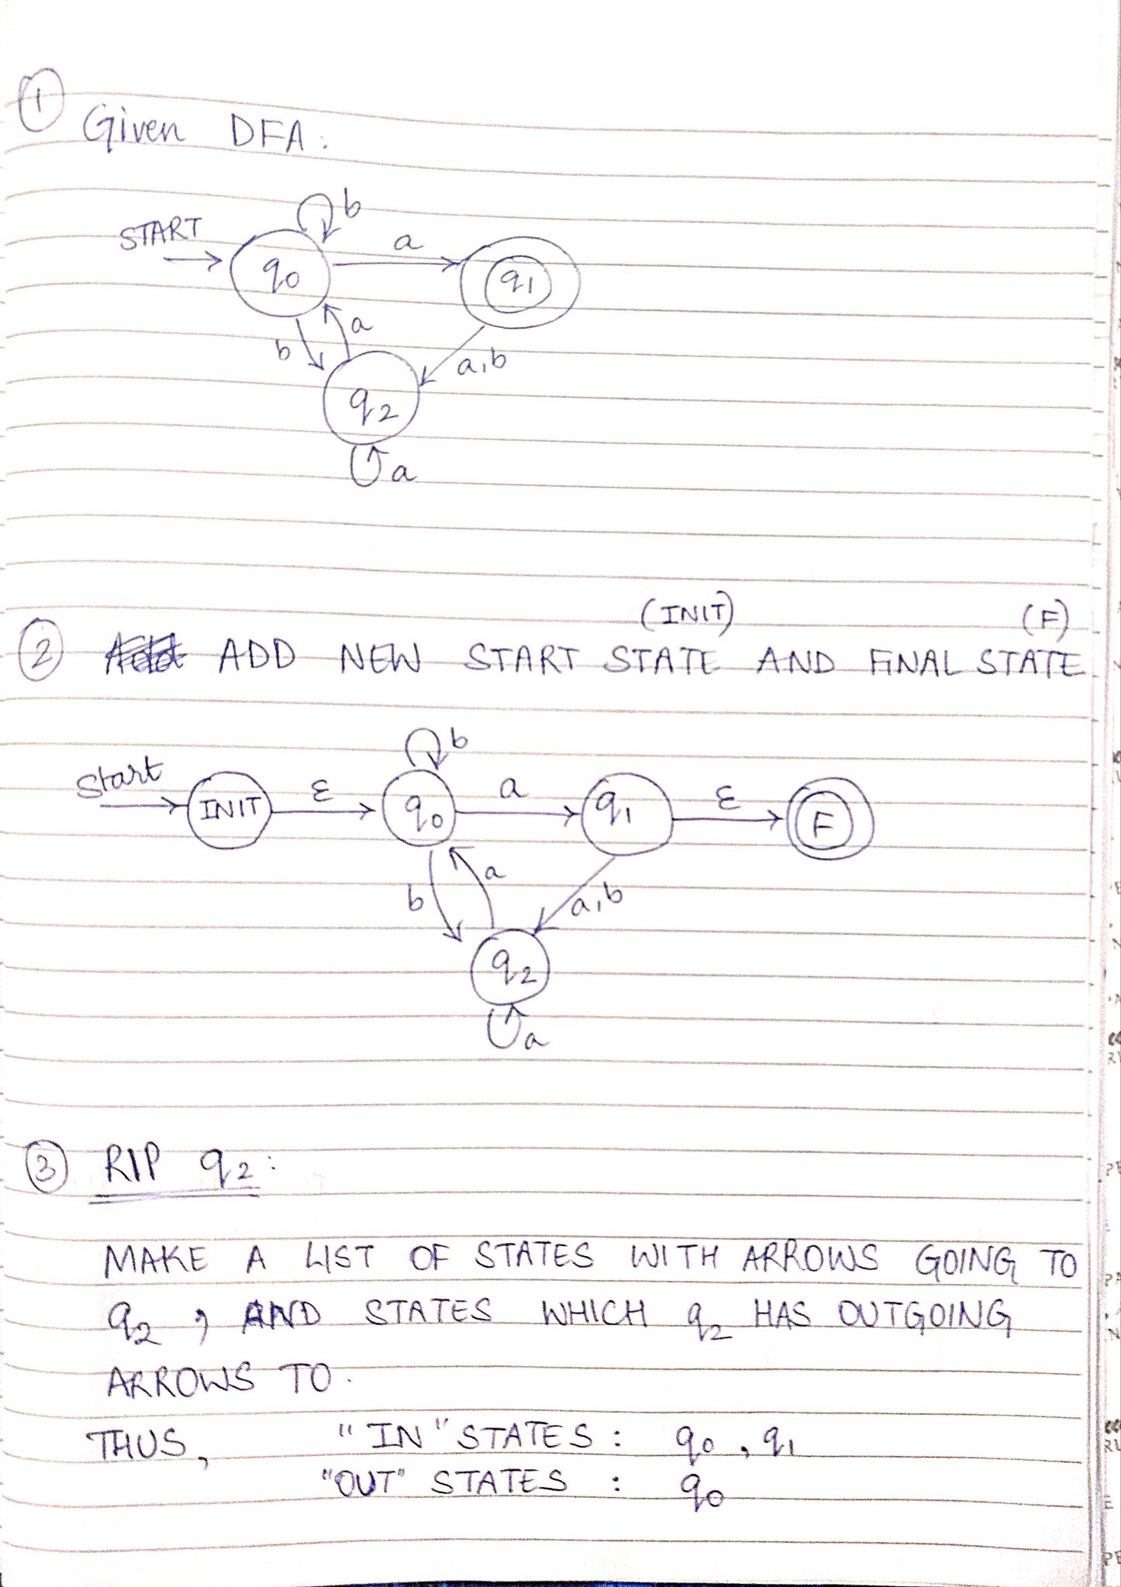
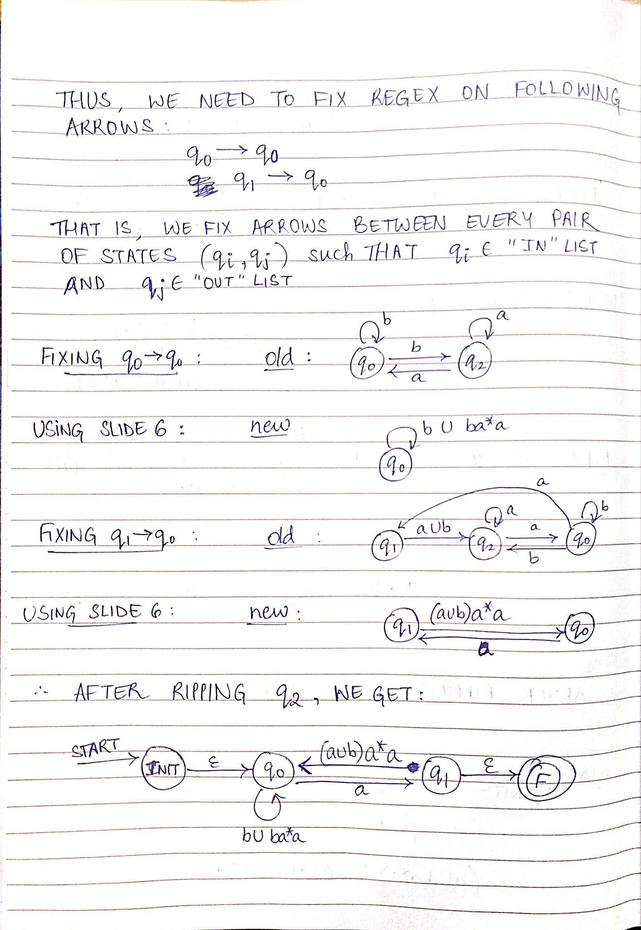
Example 1

Slide 9
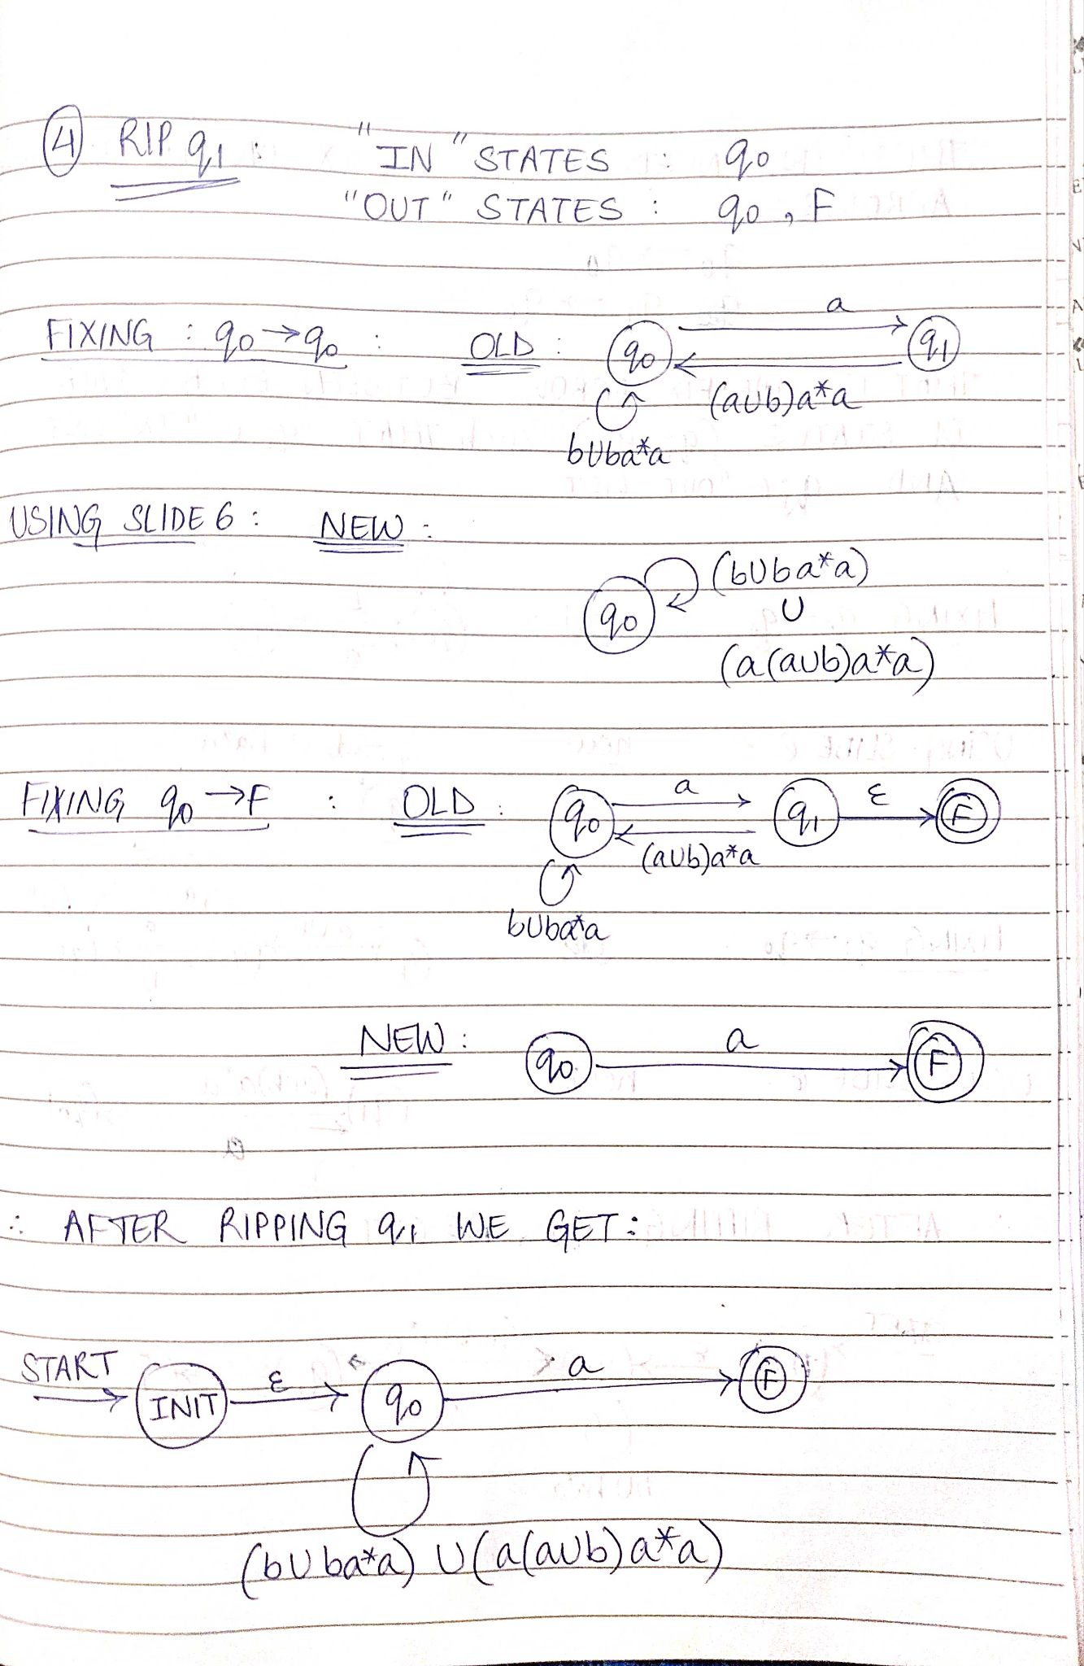
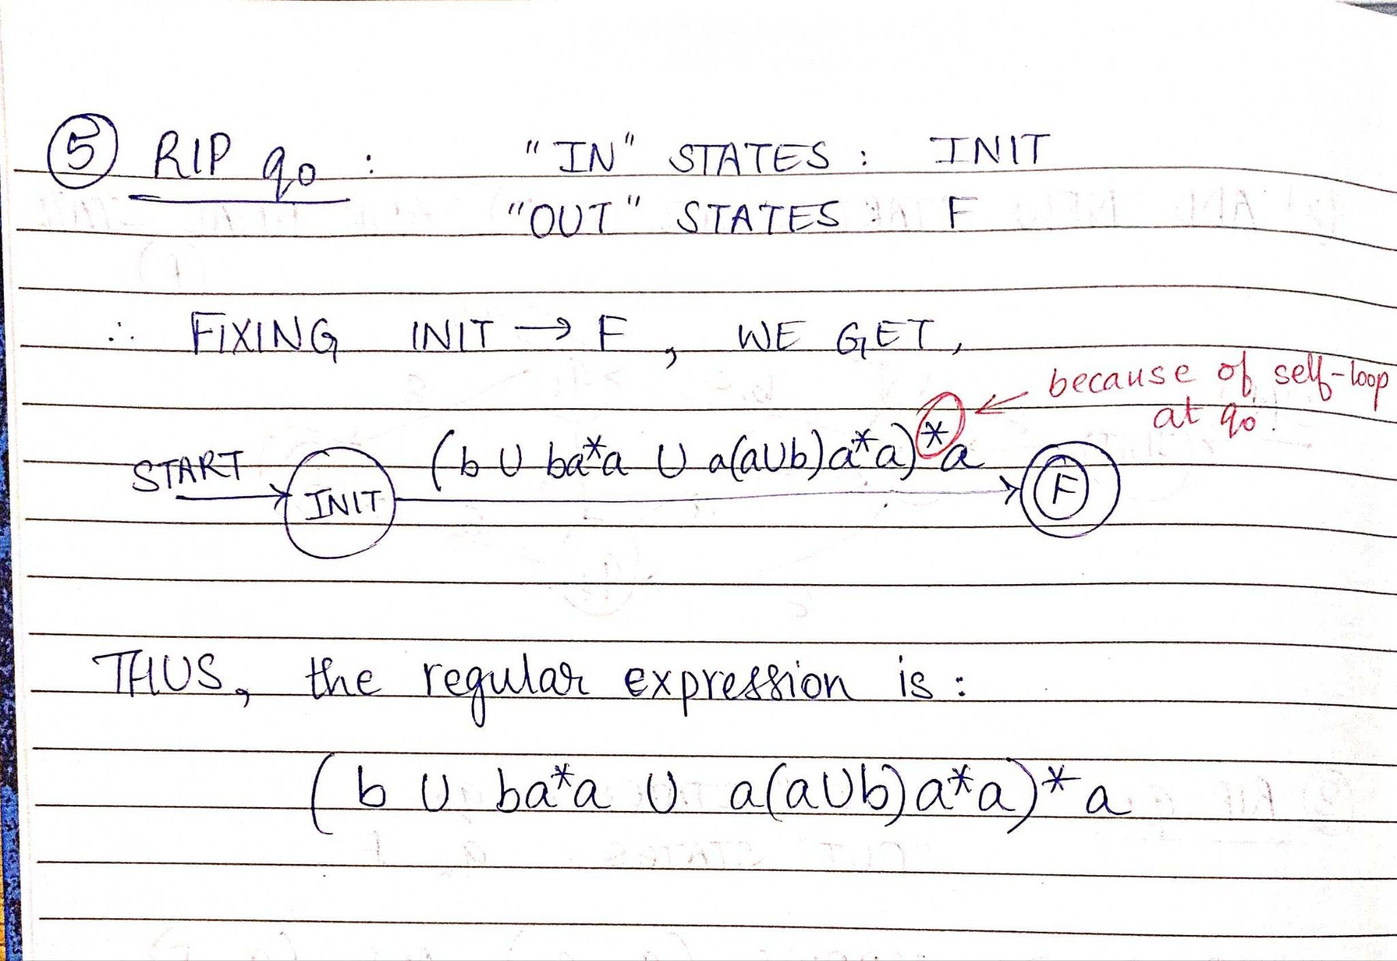
Example 1
(contd)

Slide 10
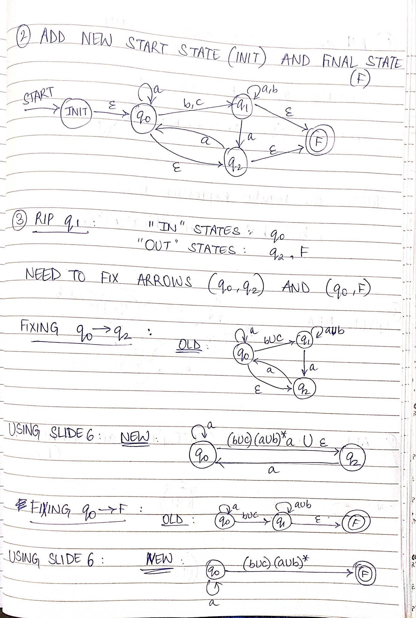
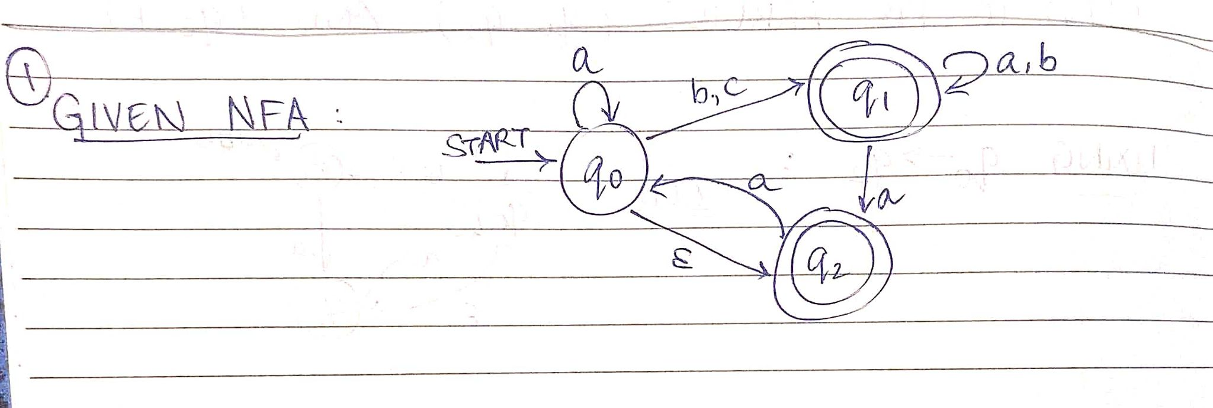
Example 2

Slide 11
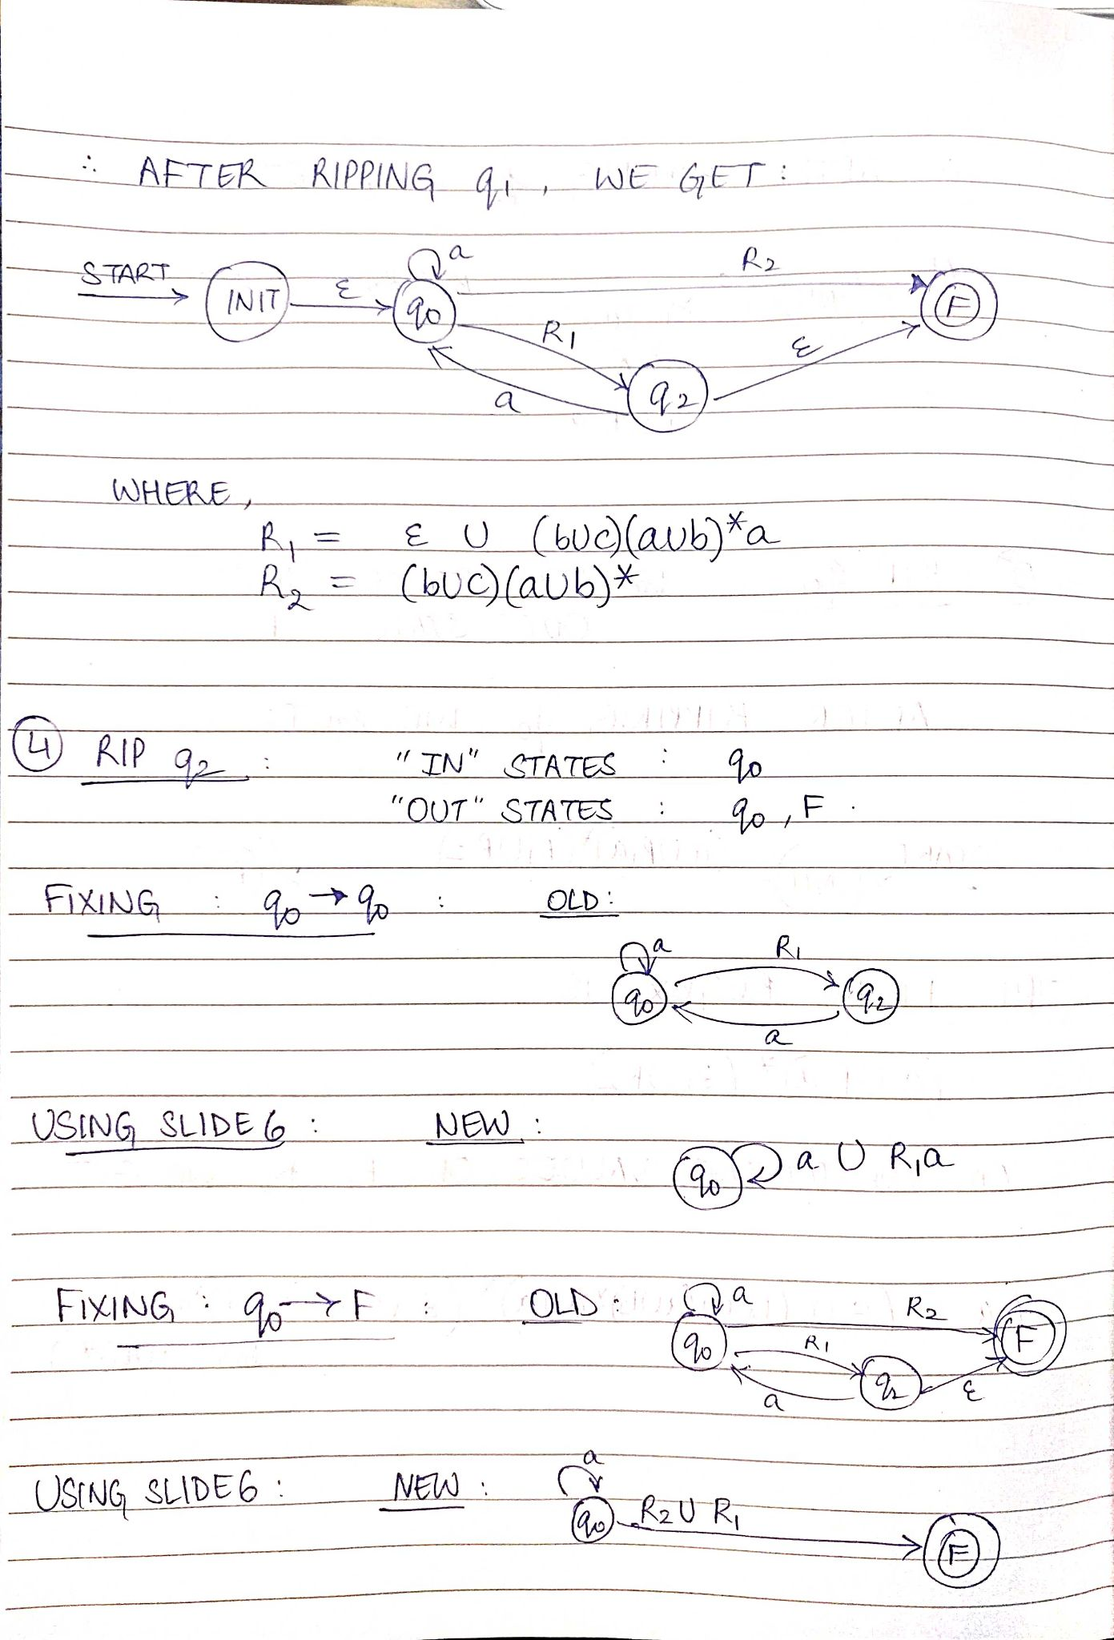
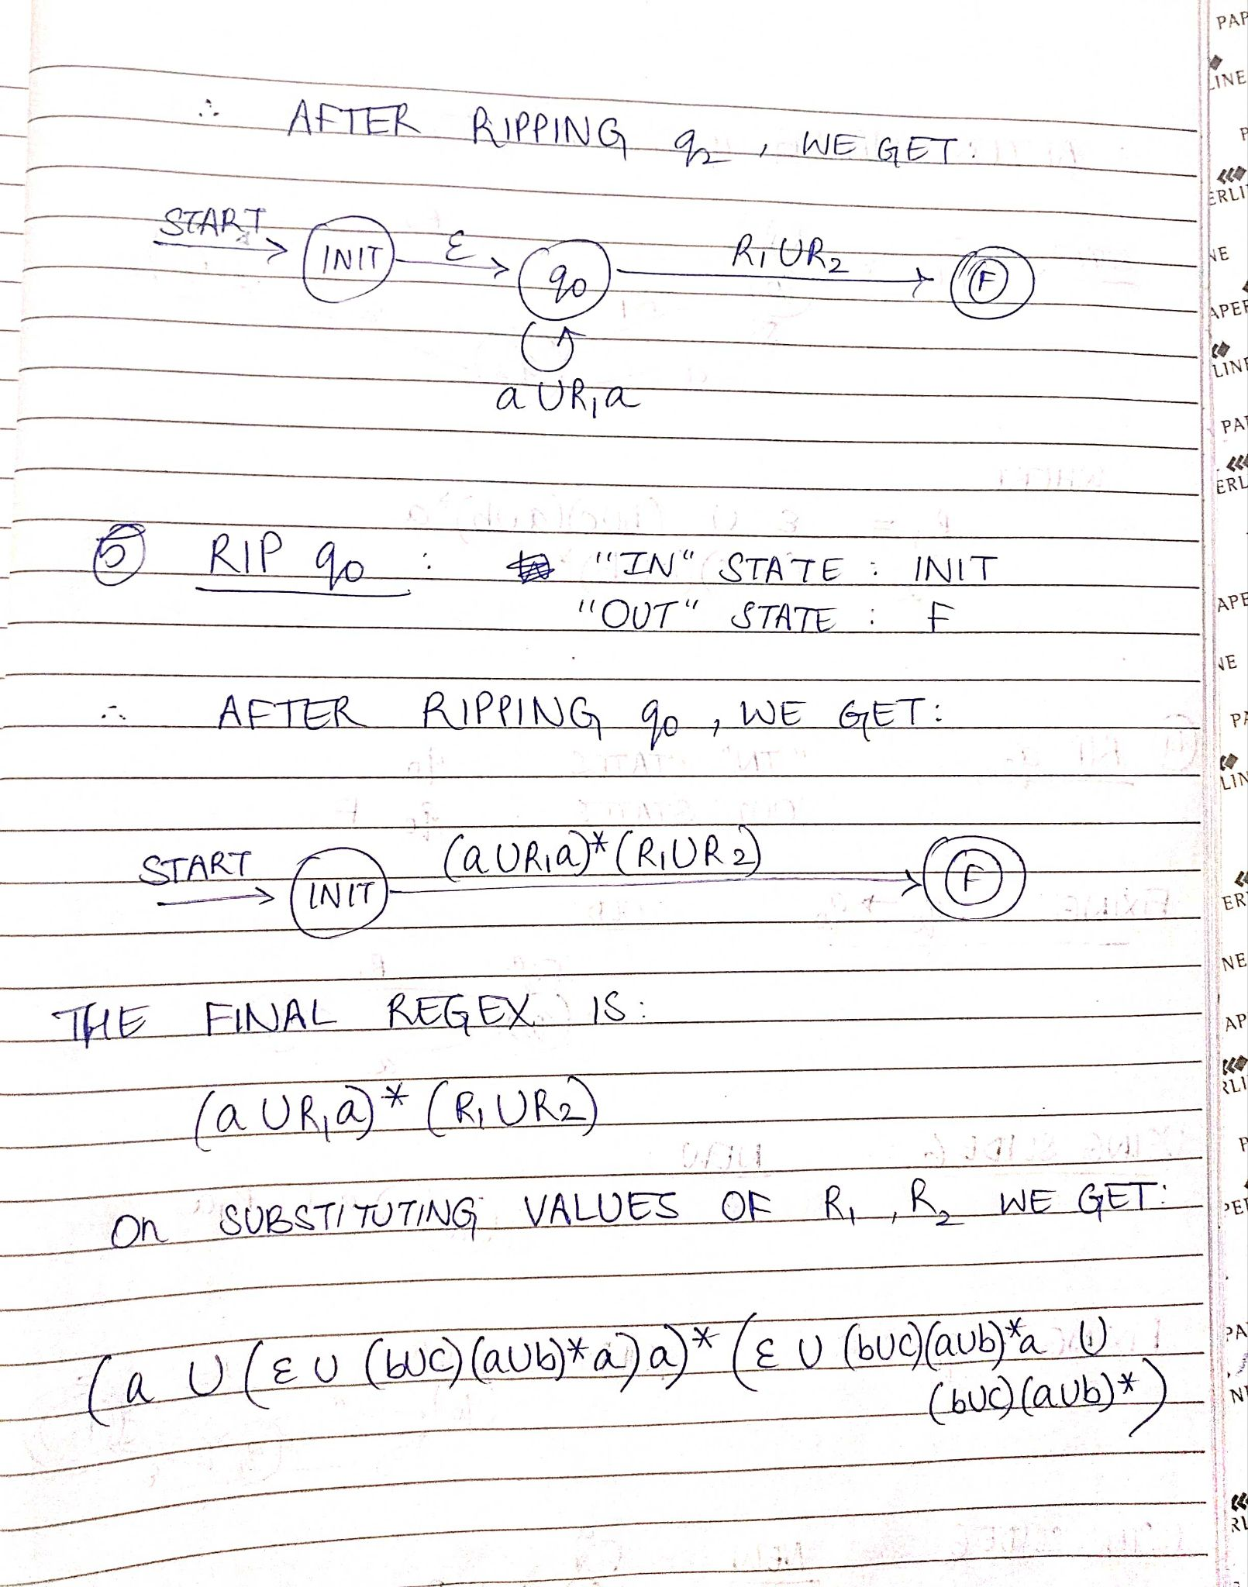
Example 2 (contd)

Slide 12
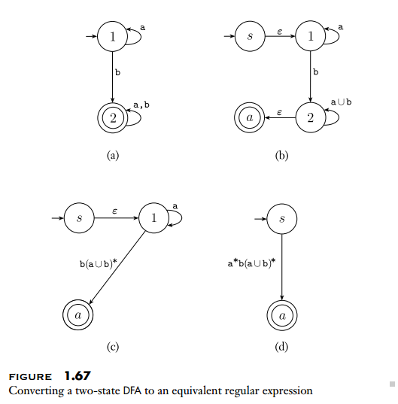
Example 3

Slide 13
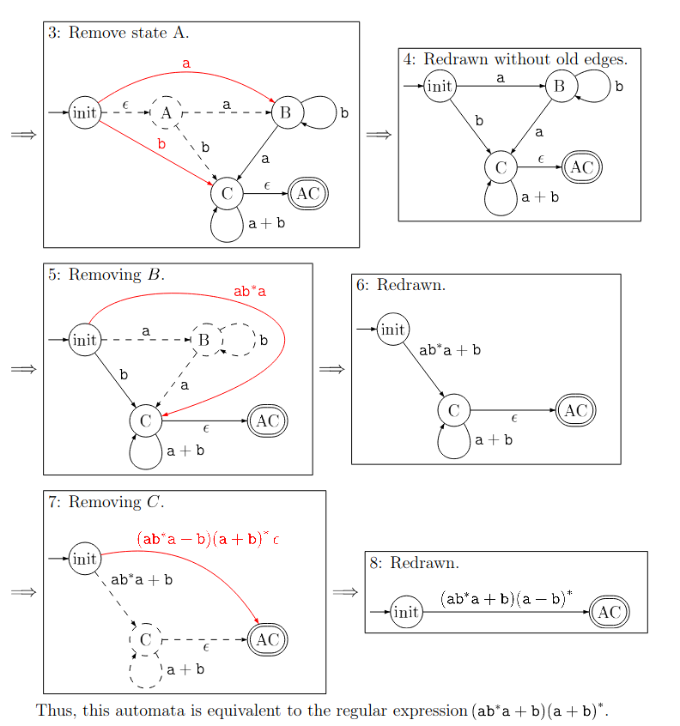
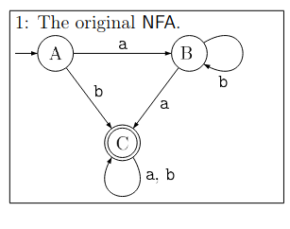
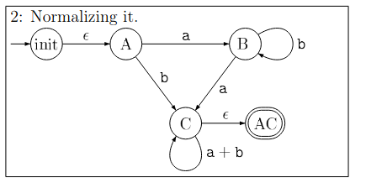
Example 4
F
F
2: Add new START (init) , FINAL (F) state. Notice, self-loop for state C is in regex form.
F
F
F
F
F

Slide 14
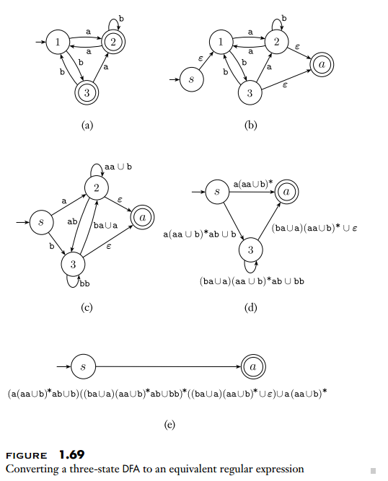
Example 5

Slide 15
Alternative algorithms
Some other algorithms that can be used to convert finite automata to a regular expression are:
Arden’s Theorem
Kleene’s Algorithm
Elimination using Brzozowski
Feel free to explore these algorithms, even though it has not been covered in this presentation.

Slide 16
References / Additional Resources
[PDF Book] Introduction to the Theory of Computation by Michael Sipser: https://drive.google.com/file/d/15qeB3VHpsZSRodiJczCnLrIqsK0nHgK_/view?usp=sharing
[PDF] Relevant lecture from Illinois : https://courses.engr.illinois.edu/cs373/sp2009/lectures/lect_08.pdf
[VIDEO] YouTube tutorials: https://www.youtube.com/watch?v=nCsY0LBuE_4 https://www.youtube.com/watch?v=Gfa3WUFVsJA

